Slide 1
Managerial Styles
Dr. Koninika Mukherjee

Slide 2
Leader vs Manager
A question of influence
Managing: Depend on formal authority inherent in designated formal rank to obtain compliance from organizational members
Leading: Does not depend solely on formal authority to influence a group toward the achievement of goals

Slide 3
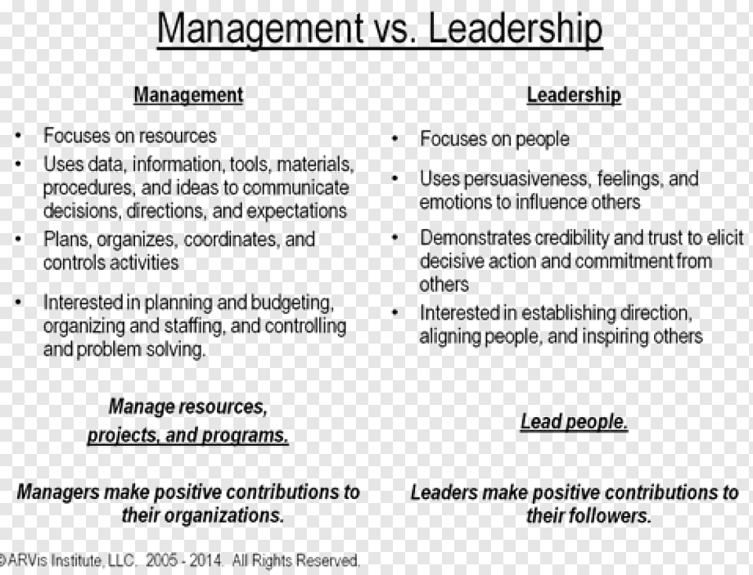

Slide 4
Leader
In 1938, Chester Bernard stated that, “leadership is the ability of a superior to influence the behavior of subordinates and persuade them to follow a particular course of action”.
A recent theorist on leadership, Williams (2005), states that, “leadership is an interactive art in which the leader is dancing with the context, the problem, the faction, and the objective”.

Slide 5
Leadership
Leadership can be formally defined as “the process of influencing the activities of an individual or a group in efforts towards the achievement of some particular goals in a given situation."
Another definition defines leadership as "Interpersonal influence exercised in a situation and directed through the communication process towards the attainment of a specialized goal(s)".

Slide 6
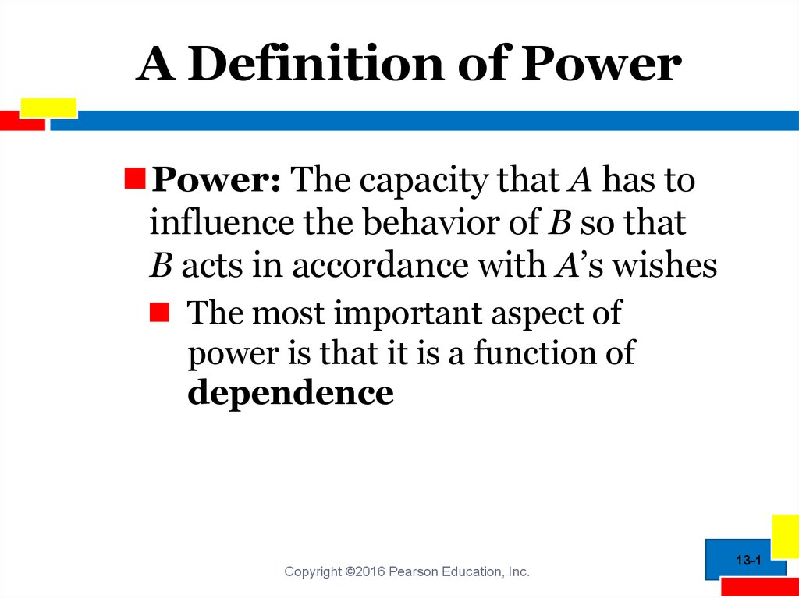

Slide 7
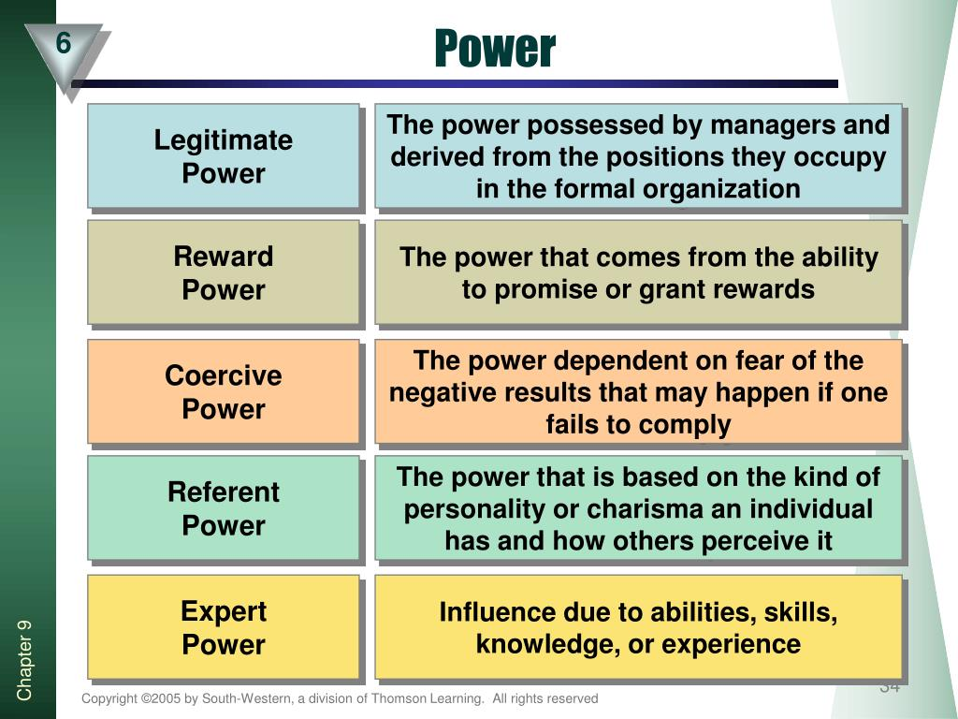

Slide 8
LEADERSHIP STYLES
The total pattern of leader actions as perceived by their employees, is called Leadership Style. It represents the leader's philosophy; skills and attitudes and behavior towards others.
The styles differ on the basis of motivation, power, or orientation towards people and tasks.

Slide 9
Theories of Leadership
Trait Theories
Behavioural Theories
Contingency or Situational Theories
Continuum of leadership behaviour
Transactional and transformational Leadership

Slide 10
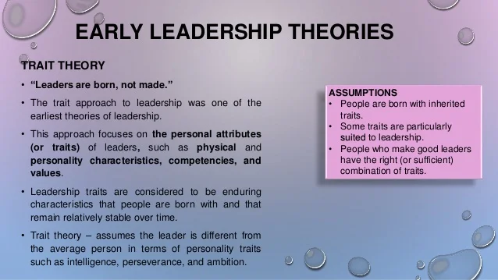

Slide 11
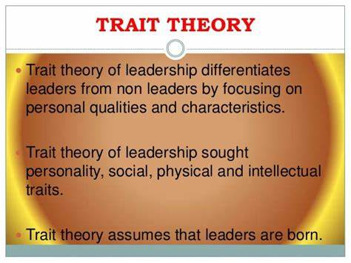

Slide 12
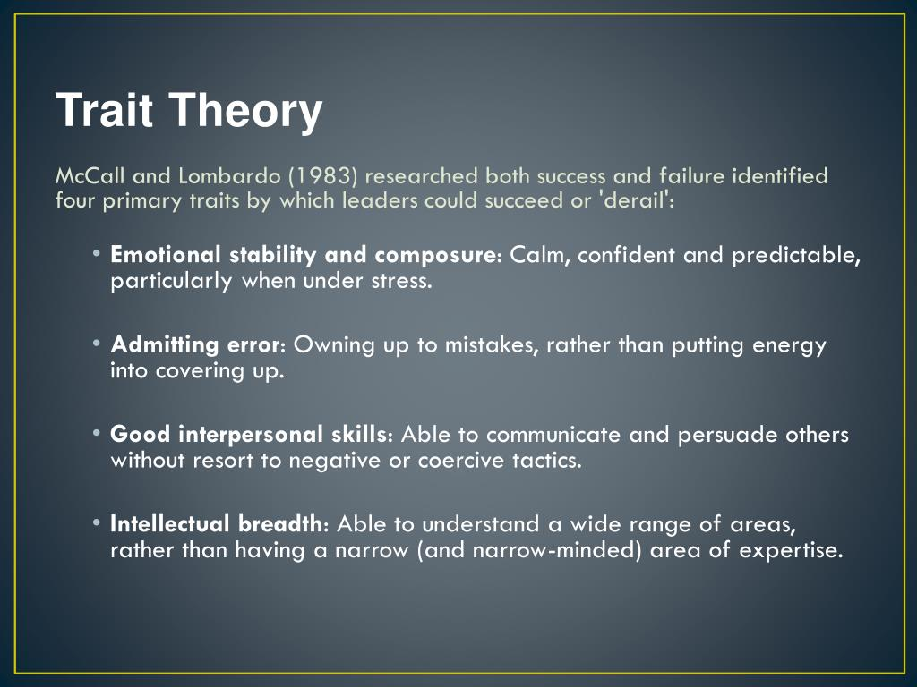

Slide 13
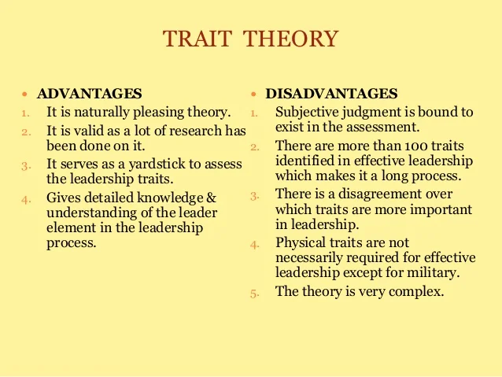

Slide 14
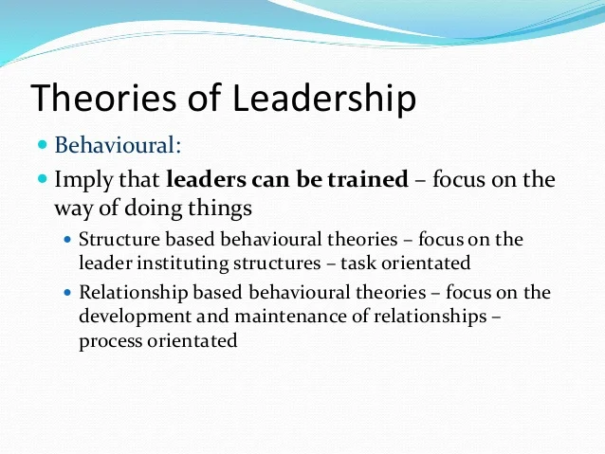

Slide 15
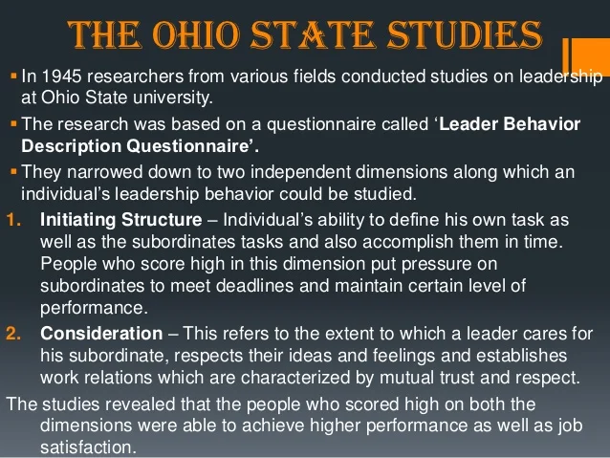

Slide 16
Examples of Task Oriented and Relationship oriented behaviors
Initiating structure | Consideration
Setting performance standards, defining roles | Finding time to listen to group members
Assigning group members to particular tasks and roles | Treating members as equal
Asking group members to follow standard rules and regulations | Looking out for personal welfare of individual group members
Maintaining definite standards of performance | Consulting the group when making decisions
Pointing out and criticizing mistakes | Gets group’s approval in important matters before going ahead

Slide 17
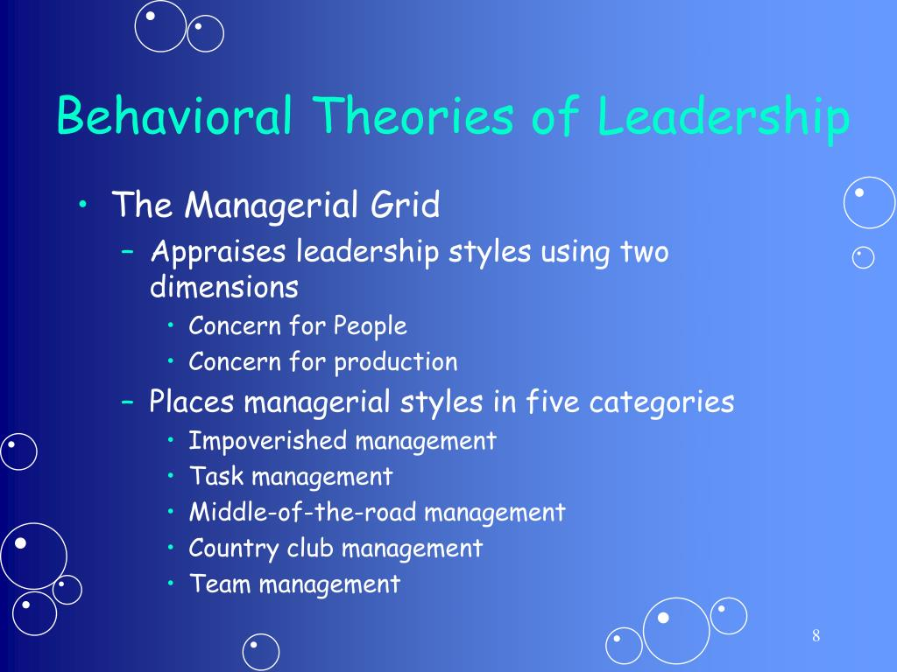
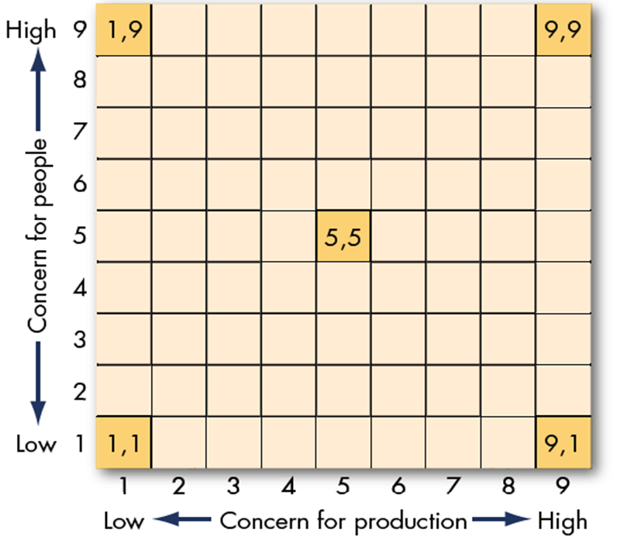

Slide 18
Managerial Style Grid
1,1 Managerial Style: It is often referred to as Impoverished Management. In this style, the manager tends to put people in jobs and then leave them alone.
9,1 Managerial Style : It is often referred to as Task Management. This manager has a high concern for production and a low concern for people. He or she plans the work and pushes to get it out. Those who can not fulfil the task are replaced by others who can.
1,9 Managerial Style: This is called as Country Club Management because of high emphasis given to concern for people's feelings, comfort, and needs. The manager is basically interested in obtaining loyalty from the subordinates and tries to motivate them to do their work without putting pressure on them.

Slide 19
Managerial Style Grid
5, 5 Managerial Style - It is often referred to as Middle-of-the-road Management. The manager assumes that there is an inherent conflict between the concerns for production and people. Therefore, he or she tries to compromise and balance the two dimensions.
9,9 managerial style - This is referred to as Team Management. It is regarded by many as the best and the ideal style, as the one that both managers in particular and the organization in general should employ. This style focuses on people's higher level needs, involves subordinates in decision making and assumes that the goals of the people and the goals of the organization are in harmony.

Slide 20
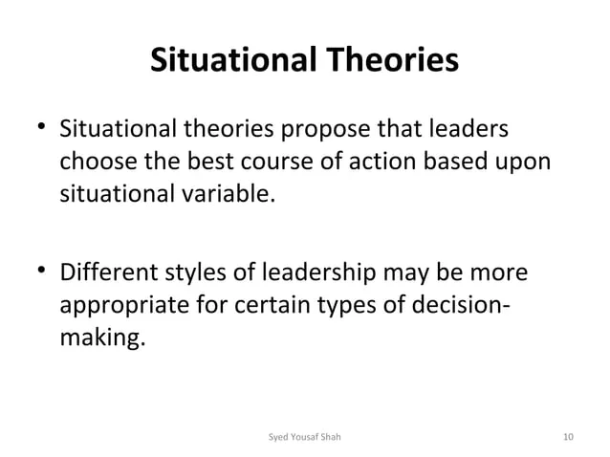

Slide 21
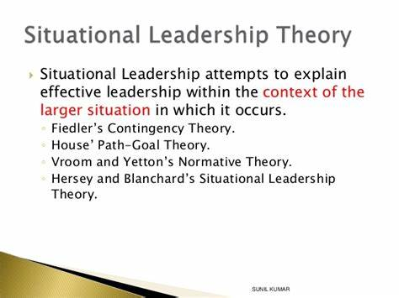

Slide 22
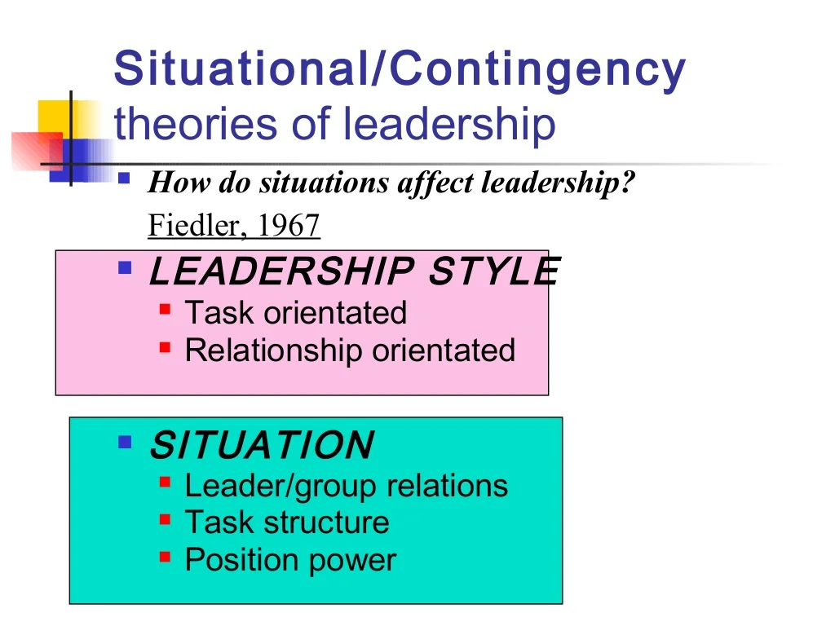

Slide 23
Situational Model
Task Style: The leader organises and defines roles for members of the work-group; the leader explains the tasks that members are to do and when, where, and how they are to do them.
ii) Relationship Style: The leader has close, personal relationships with the members of the group, and there is a two-way communication along with psychological and emotional support.

Slide 24
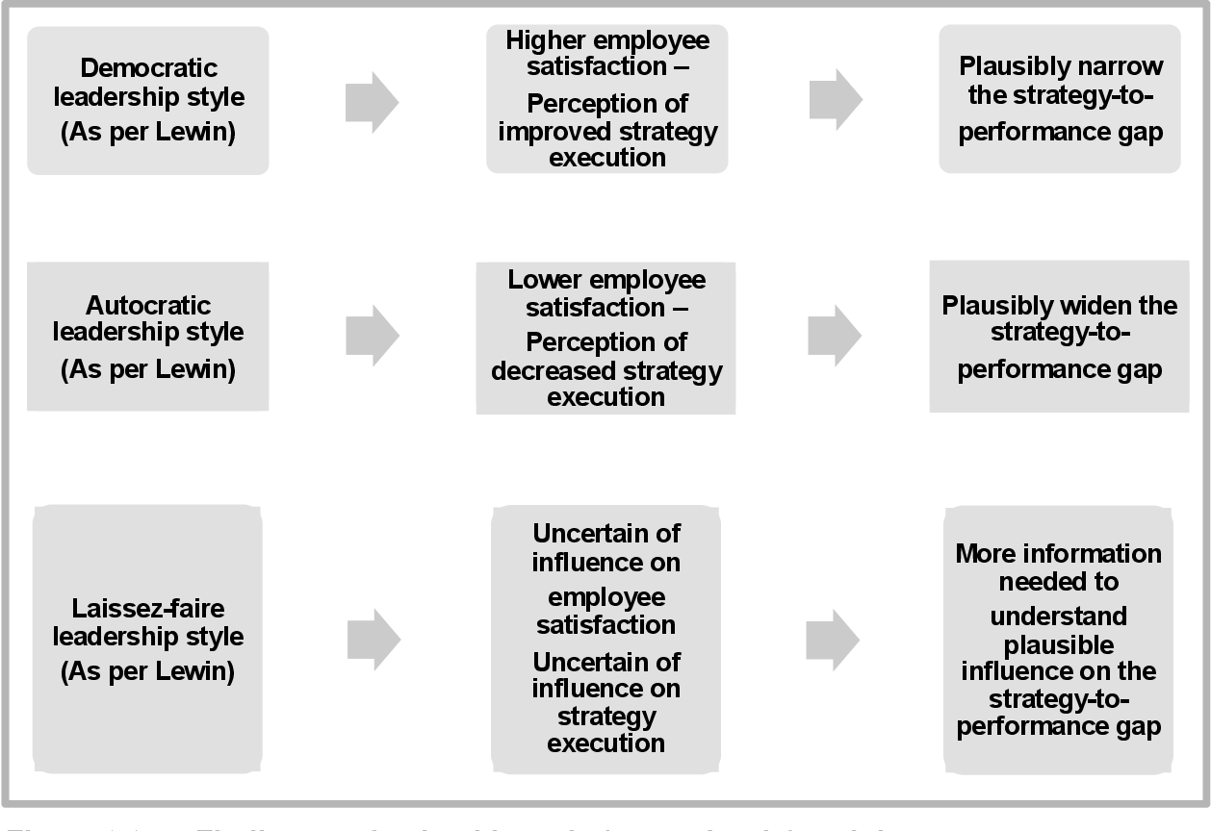
Leadership Styles (Lewin)

Slide 25
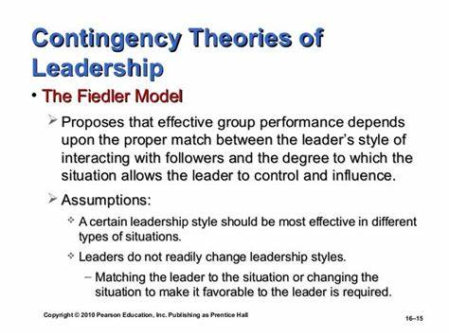

Slide 26
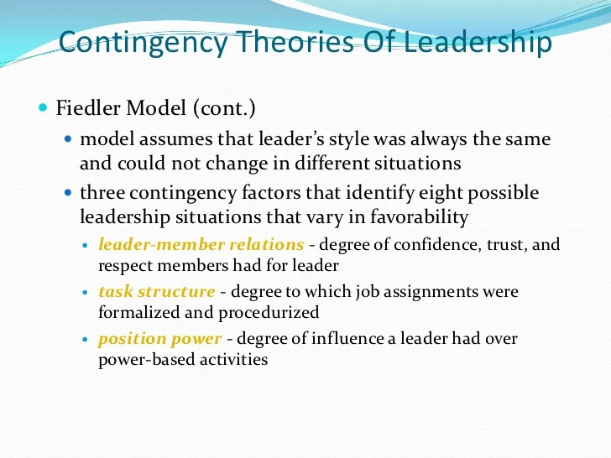

Slide 27
Limitations
One of the major drawbacks in Fiedler model is that the style adopted by a particular leader is fixed. It is assumed that a leader can follow only a particular style in any given situation and the theory suggests change of a leader to fit a situation.
Though Fiedler‟s model offers useful propositions, the practical application of the theory is highly questionable. In practice, it is generally difficult to assess how good the leader member relations are, how structured the task is, and how much position-power a leader has (Robbins, Judge, & Sanghi, 2007).

Slide 28
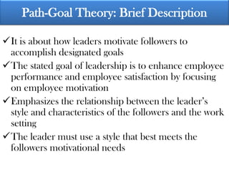

Slide 29
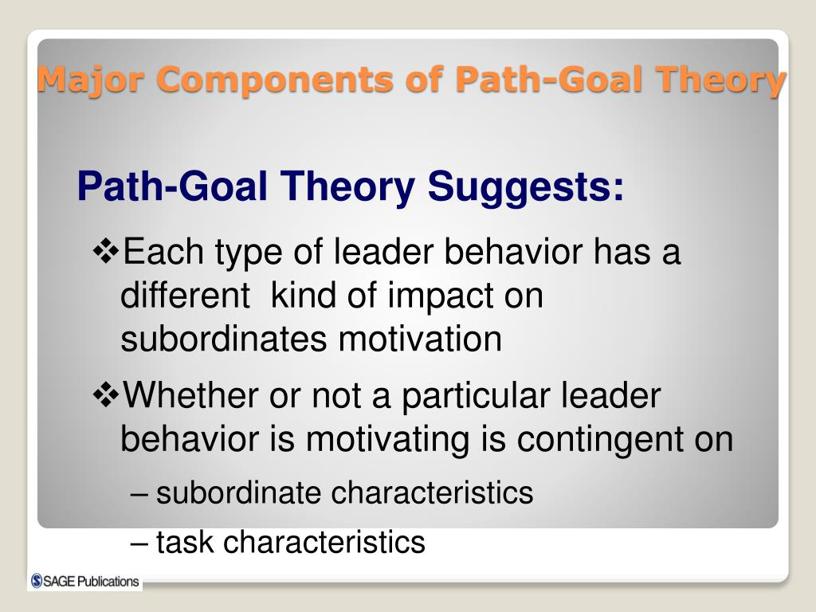

Slide 30
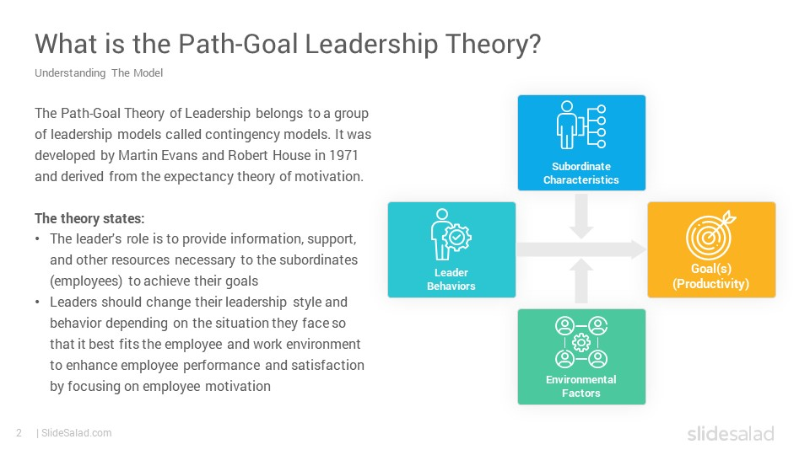

Slide 31
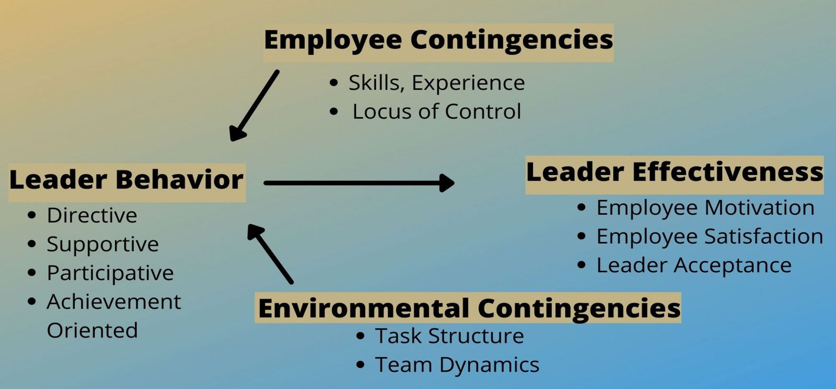
Path Goal Theory

Slide 32
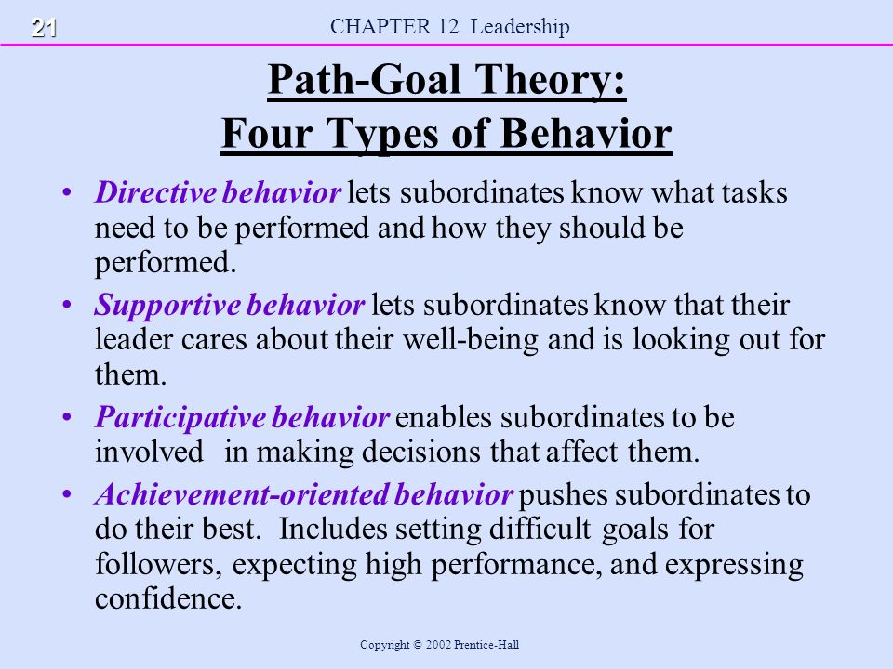

Slide 33
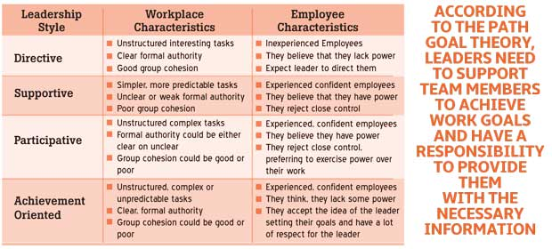
Path Goal Theory

Slide 34
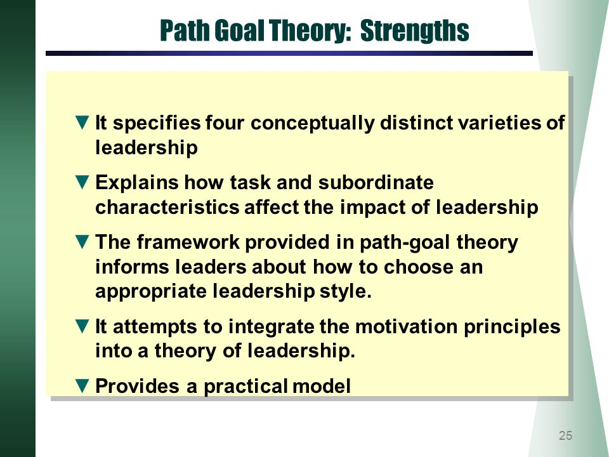

Slide 35
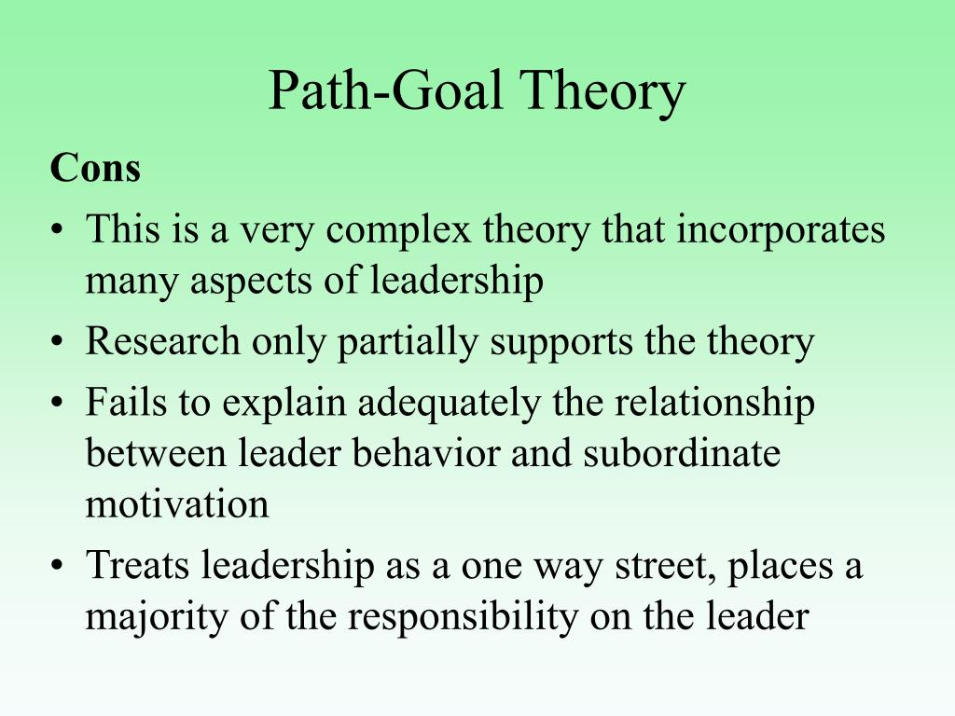

Slide 36
Continuum of leadership behaviour
In 1958, Robert Tannenbaum and Warren H-Schmidt formulated a continuum describing the decision-making authority dimension of leadership. It has two polar ends with varying amounts of leader subordinate decision-making authority. Between the two extremes of autocratic to laissez-faire fall a number of leadership styles, with the style selected dependent upon forces in the leader. the operating group, and the situation.

Slide 37
Continuum of leadership behaviour
Autocratic: In the continuum of leader authority, the autocratic end represents the manager who makes decisions and announces them to the group. The total interacting relationship and work setting have been determined by the manager and he or she provides hardly any opportunity for a subordinate to participate.
Consultative: Here the manager makes the decision concerning the work activity, its purpose, how it is to be done, when and by whom, and invites questions from subordinates.
Participative: This style indicates that the manager identifies purposes, problems and means by which activities should be carried out; presents a tentative decision already made, that is subject to change or presents the problem to subordinates, gets suggestions, and then makes the decision. Here, the area of decision making freedom for subordinates is much greater and the use of authority by the manager is much lesser than with autocratic and consultative style.

Slide 38
Continuum of leadership behaviour
Democratic: In the democratic style of leadership, the manager defines the limits of the situation and problem to be solved and asks the group to make decisions.
Laissez-Faire: This style at the far end of the continuum is called free rein, wherein subordinates are permitted to function within limits set by the manager's superior. There is no interference by the manager, who may participate in decision-making, but attempts to do so with no more influence than any other member of the group.

Slide 39
Continuum of leadership behaviour
Factors Affecting Style
The leader decision authority style adopted by the manager depends a great deal on
factors such as:
Importance of results,
Nature of the work,
Characteristics of workers, and
Personal characteristics of the manager.

Slide 40
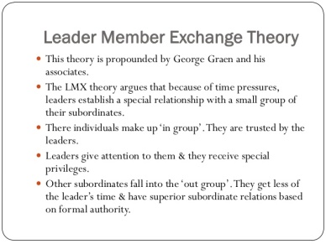

Slide 41
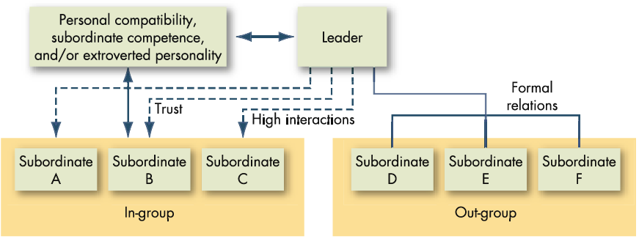
Leader-Member Exchange (LMX) model
Leaders do not have same relationships with all subordinates
These relationships may develop over time

Slide 42
Leader-Member Exchange (LMX) Theory
In-Group
Members are similar to leader
In the leader’s inner circle of communication
Receives more time and attention from leader
Gives greater responsibility and rewards
Out-Group
Managed by formal rules and policies
Receive less of the leader’s attention / fewer exchanges
More likely to retaliate against the organization

Slide 43
Transactional Theory of Leadership
The transactional theory of leadership was first discussed by Max Weber in 1947 and was later developed by Bernard M Bass in 1981. There are several assumptions that underlie the transactional theory, which are as follows:
People perform their best when the chain of command is definite and clear.
Workers are motivated by rewards and punishments.
Obeying the instructions and commands of the leader is the primary goal of the followers.
Subordinates need to be carefully monitored to ensure that expectations are met.
Under the transactional theory of leadership, the leaders guide or motivate their followers in the direction of established goals by clarifying role and task requirements.

Slide 44
Transactional Theory of Leadership
The characteristic features exhibited by transactional leaders are as follows:
Contingent Reward: The leader links the goals of the organization to rewards and clearly specifies the expectations, provides the needed resources and set goals for the subordinates.
(ii) Management by Exception (Active): The leader actively monitors the performance of the subordinates, watches and searches for deviations from rules and standards, and take corrective actions to prevent mistakes.
(iii) Management by Exception (Passive): In terms of passive management, a leader intervenes only if standards are not met and even use punishments for poor performances.
(iv) Laissez-Faire: the leader gives an environment to subordinates, where they can take decisions. In this form, the leader himself abdicates from responsibilities and avoids making decisions, due to which the followers lack the direction.

Slide 45
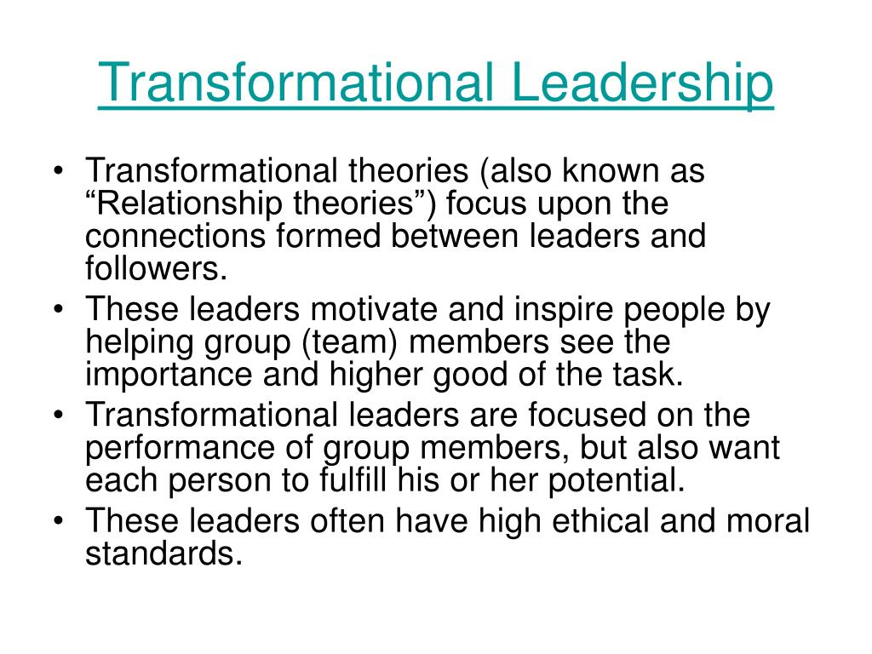

Slide 46
Transformational leadership
Idealized Influence – Providing a role model for high ethical behavior, instills pride, gains respect and trust
Inspirational Motivation – articulating a vision that is appealing and inspiring to followers.
Intellectual Stimulation – challenging assumptions, takes risks and solicits followers' ideas. Leaders with this style stimulate and encourage creativity in their followers. They nurture and develop people who think independently.
Individualized Consideration – the degree to which the leader attends to each follower's needs, acts as a mentor or coach to the follower and listens to the follower's concerns and needs.

Slide 47
Transformational-Charismatic leadership
Transformational leadership
in essence - inspiring and stimulating followers to develop themselves
successful transformational process may reduce attribution of charisma to leader
tends to do things to empower followers, make them less dependent on the leader
mutuality in leader-follower relationship - both leader and follower “transformed” simultaneously, influence process is reciprocal
Charismatic leadership
in essence - being charismatic is to be perceived by followers as extraordinary;
followers are dependent on the leader for guidance and inspiration
usually engage in behaviors that foster an image of extraordinary competence and thus increase follower dependence
influence processes are primarily intended to align followers’ vision with that of the leader
Mittal, R. (2015). Charismatic and transformational leadership styles: A cross-cultural perspective. International Journal of Business and Management, 10(3), 26.

